Slide 1

Retirement planning
June 18, 2021
Notes:
Don’t forget to record.
As you know, we do a lot of work at Stepstone to help clients with their investments, but we don’t ever share resources to help each other with our own investments. I enjoy researching this stuff and discussing it with people, so I decided to put together a presentation to try and simplify some investing concepts, share them with you, and I hope you find something helpful in these next 20 minutes or so.

Slide 2
The Agenda
Outline The problem
Practical steps to fix the problem
Background information and resources
Disclaimer: This presentation does not claim to provide personal investment advice. While the information provided is believed to be accurate, it may include errors or inaccuracies. Conduct your own due diligence or consult a licensed financial advisor before making any investment decisions.
Notes:
Just so you know, I don’t claim to be an expert by any means. A lot of this you may already know. But I just feel like there’s a lackluster effort by most people to do the research about something that is incredibly important for your future. I also want to make sure that this is more of a discussion than just a presentation, because I’m sure you guys have additional ideas that I haven’t covered.

Slide 3
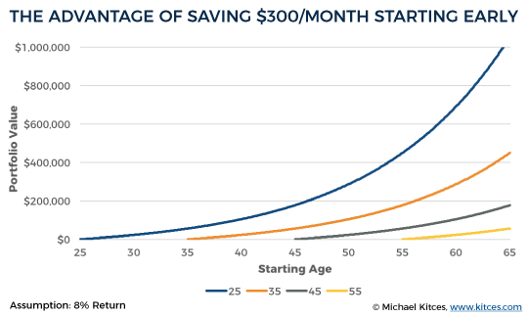
The Problem
Americans feel unprepared for retirement. One in three have less than $5,000 in retirement savings, and one in five have no retirement savings at all.
Waiting to invest in your retirement is missing out on the magic of compounding interest, as well as free money.
Most Americans expect Social Security to be a significant source of income when they retire, but Social Security is on track to be depleted by 2034.
Discussion/questions/comments/ideas
Notes:
Compounding interest is the interest gained on an account based on both the initial amount and the accumulated interest from previous periods.
Social Security is basically an insurance program. Workers pay into the program, and it pays benefits to those eligible for them - retirement benefits start at age 62.
The problem is that the Social Security Administration (SSA) predicts that 13 years from now, there will be more retirees and fewer workers. When that happens, either workers will be taxed more, Congress may intervene, or retirees will receive less benefit.

Slide 4
The Goal
If you are earning $60,000 by age 30, you should have $60,000 banked for retirement.
By age 40, you should have three times your annual salary.
By age 50, six times your salary;
By age 60, eight times;
and by age 67, ten times.
If you reach 67 years old and are earning $120,000 per year, you should have $1,200,000 saved.
Note: these are just general guidelines and can vary based on your income. Upper income individuals should have more saved because Social Security provides a lower percentage of their retirement income.
Age | Income | Multiple | Total Saved
30 | $60k | 1x | $60k
40 | $80k | 3x | $240k
50 | $100k | 6x | $600k
60 | $120k | 8x | $960k
Discussion/questions/comments/ideas
Notes:
These are pretty lofty goals put out by Fidelity, but something we should keep in mind.

Slide 5
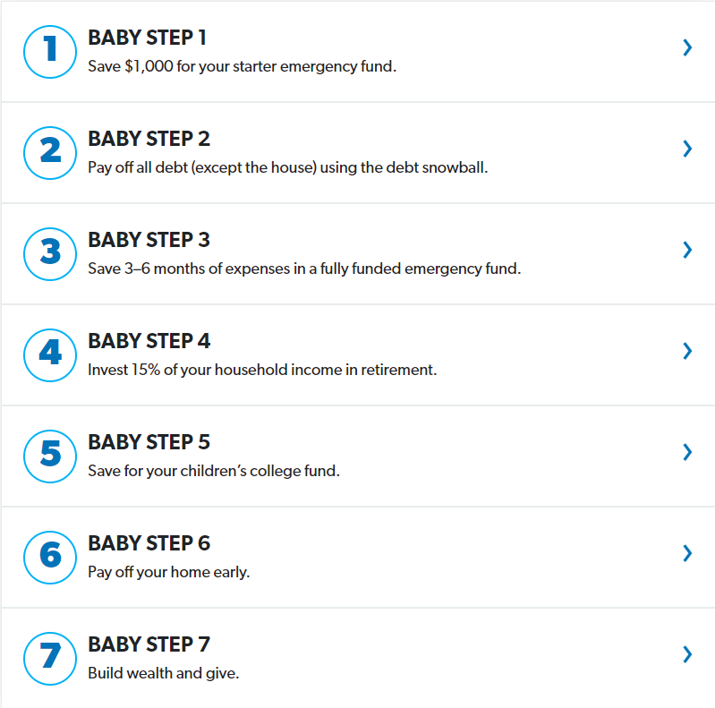
The Baby Steps
Discussion/questions/comments/ideas
Scenario:
You owe $5000 for student loans, at 4% interest rate.
You have $8000 in your savings account accruing 0.8% interest.
By not paying off the loan, your money is becoming the bank’s money.
We will be focusing
On Step 4
Note: even though retirement investing starts at Step 4, you should at least set up a 401(k) to take advantage of free money! (SSG gives 3%, not a match)
Notes:
In this first step, your goal is to save $1,000 as fast as you can. Your emergency fund will cover those unexpected life events you can't plan for. And there are plenty of them. You don’t want to dig a deeper hole while you’re trying to work your way out of debt!
Step 2
Next, it’s time to pay off the cars, the credit cards and the student loans. Start by listing all of your debts except for your mortgage. Put them in order by balance from smallest to largest—regardless of interest rate. Pay minimum payments on everything but the little one. Attack that one with a vengeance. Once it's gone, take that payment and put it toward the second-smallest debt, making minimum payments on the rest. That's what's called the debt snowball method, and you’ll use it to knock out your debts one by one.
Step 3
You’ve paid off your debt! Don’t slow down now. Take that money you were throwing at your debt and build a fully funded emergency fund that covers 3–6 months of your expenses. This will protect you against life’s bigger surprises, like the loss of a job or your car breaking down, without slipping back into debt.
(click and show scenario)
Step 4
It's time to get serious about retirement—no matter your age. Take 15% of your gross household income and start investing it into your retirement. Start with your company’s 401(k) plan and invest up to the full employer match. Then invest the rest into Roth IRAs—one for you and one for your spouse (if you’re married).
Step 5
Next, it's time to save for your children’s college expenses. The recommendation is a 529 college savings plan or ESA (Education Savings Account).
Baby Step 6 is the big dog! Your mortgage is the only thing between you and complete freedom from debt. Can you imagine your life with no house payment? Any extra money you can put toward your mortgage could save you tens of thousands of dollars in interest.
Last Step
You know what people with no debt can do? Anything they want! The last step is the most fun. You can live and give like no one else. Keep building wealth and become outrageously generous, all while leaving an inheritance for your kids and their kids.

Slide 6
The Investments
Discussion/questions/comments/ideas
 | 401(k) | IRA | Roth IRA
Maintained by | Employer | Self | Self
Upfront taxes | No | No | Yes
Withdrawal taxes | Yes | Yes | No
Contribution limits | $19,500/yr | $6,000/yr | $6,000/yr
Employer match | YES! (free money) | No | No
Income limits | No | Yes | Yes
Average fees | High | Low | Low
A good strategy (if you can manage it) is to have both a 401(k) and a Roth IRA. Invest in your 401(k) up to the matching limit,
then fund a Roth up to the contribution limit. After that, any leftover funds can go toward your 401(k)’s contribution limit.
SSG 401(k) is managed by Transamerica and SSG contributes 3% of your compensation each year.

Slide 7
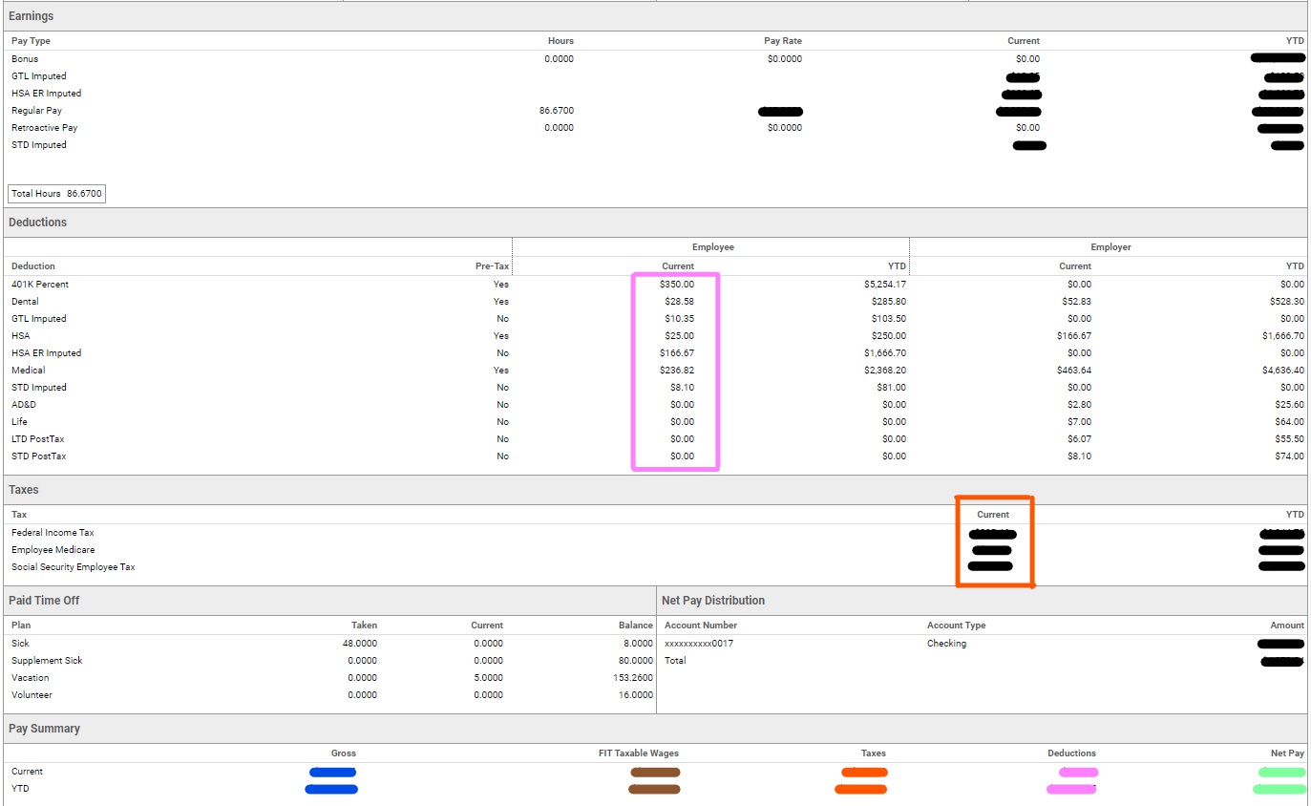
Increasing your 401(k) contribution increases deductions, which lowers your taxable wages
That means paying less in taxes now, but paying more in taxes when you retire
Discussion/questions/comments/ideas
Gross – Deductions = Taxable Wages
Contributing to a Roth IRA comes out of Net Pay (that you’ve already been taxed on)
Taxable Wages x Your Tax Bracket =
Taxes
That means paying more in taxes now, but no taxes on it when you retire

Slide 8
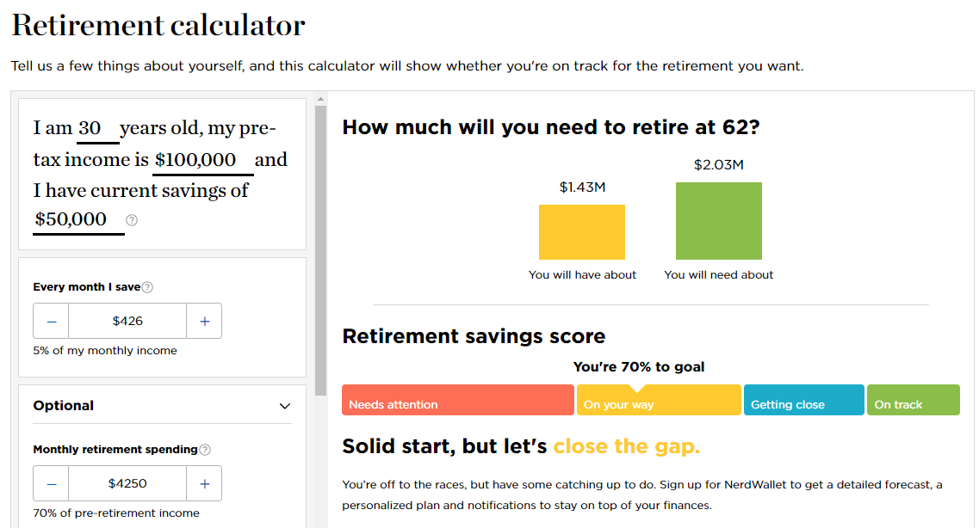
The Resources
https://www.investopedia.com/
For researching investment terms and definitions
https://www.nerdwallet.com/investing/retirement-calculator
To forecast your retirement based on your circumstances
http://daveramsey.com
Baby steps and other financial resources
Discussion/questions/comments/ideas

